Slide 1
CURRENT AND PROJECTED PREVALENCE OF ARTERIAL HYPERTENSION IN SUB-SAHARAN AFRICA BY GENDER, AGE AND HABITAT: A META-ANALITICAL ANALYSIS OF POPULATION STUDIES DATA.
Marc Twagirumukiza^{1,2}, Dirk De Bacquer³, Jan Kips¹ , Guy de Backer³, R Vander Stichele¹, and Luc M. Van Bortel¹.
¹Heymans Institute of Pharmacology, Ghent University, Ghent, Belgium
²Faculty of Medicine, National University of Rwanda, Butare, Rwanda.
³Department of Public Health, Ghent University, Ghent, Belgium.

Slide 2
Settings
Background
  Data on the prevalence and burden of hypertension in sub-Saharan Africa (SSA) are either lacking, either heterogeneous.
  Currently no estimates of overall prevalence of hypertension in SSA. (However in the last WHO/AFRO meeting estimates stated that around 20 millions !)
  Studies on the difference in hypertension prevalence between urban and rural areas report large variations and sometimes contradictory results.
  The impact of urbanization on men and women is scarcely explored.
Objective :
  To assess the difference in hypertension prevalence between urban and rural areas in SSA, and the impact of gender.
  To estimate the overall prevalence of hypertension in Sub-Saharan Africa (SSA) countries from population studies

Slide 3
Methods
Population studies published between 1998 and 2008 were retrieved from databases as MEDLINE through PubMed, EMBASE, African Index Medicus and WHO Global Cardiovascular InfoBase.
Inclusion: Use the most recent definition of hypertension (SBP/DBP ≥140/90 mmHg + being on anti-hypertensive treatment) and are conducted according the World Health Organization STEP-wise methodology or a similar approach.
The influence of gender was assessed and then rural and urban data were analyzed separately. All prevalence were age-standardized using 2008 country/SSA population.
If in a country more than one study was available, the weighted mean prevalence was calculated.

Slide 4
Pooled prevalence of Hypertension in SSA , from 15 population studies of 11 countries
AGE | Pooled Prevalence |  |  |  | Total adult population | All hyperte-nsives | Calculated prevalence
 | Male |  | Female |  |  |  | Urban | Rural |  | Men |  | Women |  | All
 | Urban | Rural | Urban | Rural
15-24 | 7.12 | 5.7 | 4.48 | 3.56 | 165,476,317 | 8,369,839 | 20.7 | 13.7 |  | 16.8 |  | 15.7 |  | 16.2
25-34 | 13.58 | 9.55 | 9.86 | 6.84 | 115,943,524 | 10,996,648
35-44 | 24.37 | 15.57 | 20.32 | 12.74 | 74,689,253 | 12,788,663
45-54 | 39.78 | 24.37 | 37.29 | 22.49 | 49,276,086 | 14,195,235
55-64 | 57.52 | 36.02 | 58.11 | 36.58 | 31,526,626 | 13,886,165
≥65 | 73.51 | 49.59 | 76.38 | 53.41 | 24,074,117 | 14,470,484
in total |  |  |  |  | 460,985,923 | 74,707,034
Confidence Intervals |  |  |  |  |  | 65,237,345 | 17.1 | 9.5 | 13 |  | 12.2 |  | 14.2
 |  |  |  |  |  | to | to | to | to |  | to |  | to
 |  |  |  |  |  | 93,413,265 | 23.3 | 16.9 | 21.1 |  | 18.3 |  | 20.3

Slide 5
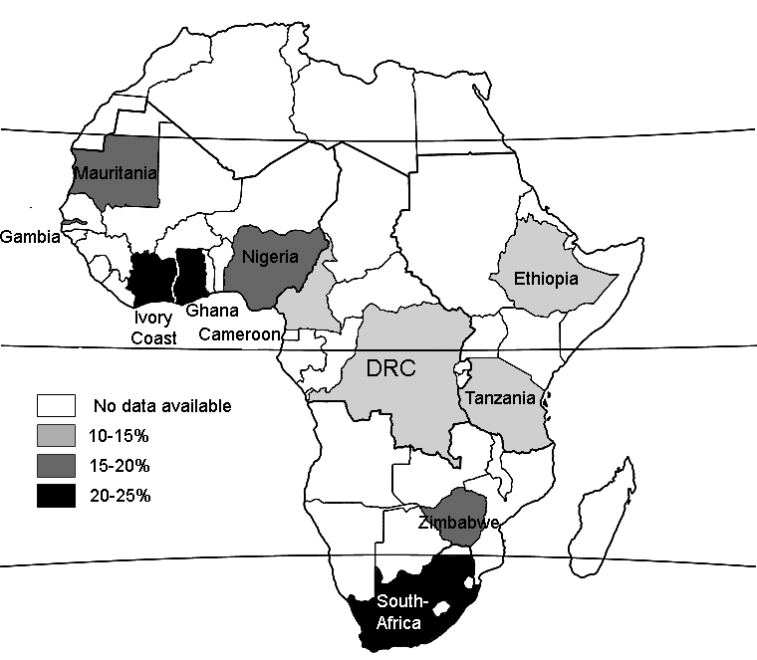
Prevalence of Hypertension in 11 SSA , countries

Slide 6
Results
Rural/urban prevalence by study (only for age range of 25-64 years)
 | Urban vs. Rural
Studies (by author, year, and country) | OR (95% CI)^{(a)} | p-value
Mbanya JC et al, 1998 (Cameroon) | 2.66 (1.90 to 3.74) | <0.0001
Van der sande MA et al, 2000 (Gambia) | 2.08 (1.74 to 2.48) | <0.0001
Agyemang C et al, 2006 (Ghana) | 1.83 (1.36 to 2.47) | <0.0001
Cappuccio FP et al, 2004 (Ghana) | 1.55 (1.10 to 2.18) | 0.01
Edwards et al. (Tanzania 2000) | 1.50 (1.04 to 2.17) | 0.03
WHO STEPs report, 2005 (Madagascar) | 1.40 (1.16 to 1.68) | 0.0003
(a) Adjusted for age and gender.

Slide 7
Rural/urban prevalence by age
 | Prevalences(a) |  | Statistics OR(95%CIs)
 | Urban | Rural
15-24 years | 7.8% (86/1099) | 6.7% (70/1044) | 1.18 (0.84-1.66)
25-34 years | 16.2% (362/2237) | 10.9% (216/1979) | 1.58 (1.32-1.90)*
35-44 years | 22.5% (295/1309) | 12.3% (162/1314) | 2.07 (1.67-2.57) *
45-54 years | 33.2% (240/723) | 24.0% (233/969) | 1.57 (1.27-1.96) *
55-64 years | 55.4% (279/504) | 42.2% (420/995) | 1.70 (1.36-2.12) *
65+ years | 54.3% (94/173) | 38.7% (86/222) | 1.88 (1.23-2.87) *
All ≥ 15 years | 22.4% (1356/6045) | 18.2% (1187/6523)
Age-stand(b) | 24.2% | 16.9% | 1.65 (1.45-1.89*
All 15-64 years | 21.5% (1262/5872) | 17.5% (1101/6301)
Age-stand(b) | 23.3% | 16.2% | 1.29 (1.18-1.42) *
Obtained by pooling 6 population studies from 5 countries (Cameroon, Gambia, Ghana, Tanzania and Madagascar).
using every country population as reference; *Statistically significant

Slide 8
Urban vs Rural and Gender prevalence by age
Gender | Urban vs. Rural OR (95% CI)
 | Age ≥ 15 years | Age 25-64 years
Men | 2.09 (1.73 to 2.52) | 2.37 (1.93 to 2.92)
Women | 1.75 (1.47 to 2.08) | 1.87 (1.55 to 2.26)
Both sexes | 1.93 (1.70 to 2.19) | 2.11 (1.84 to 2.42)
Based on studies reporting gender data, the risk of becoming hypertensive in adult (15 years+) was in urban areas 2 times higher than in rural areas in men and 1.75 times higher in women, but the difference between two sexes was not statistically significant.
The differences in prevalence of hypertension between urban and rural populations are of comparable magnitude for men and women.

Slide 9
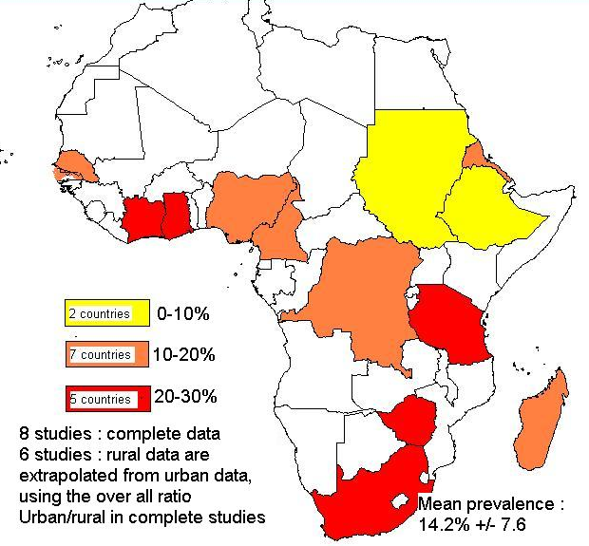
Prevalence of Hypertension in SSA, extrapolation and projections
Pooled
prevalence
In whole
SSA
2008 :
16.2%
(CI_{95%:} 14.2 - 20.3)
2008:
74.7 Mio
20 Mio (WHO/AFRO)
2025:
125.5 Mio
(CI_{95%}: 111.2 -162.8)

Slide 10
Hypertension prevalence in Africa Vs Western countries
Age (years) | SSA (1) |  | England (2) |  | USA (3)
 | Samples (n) | Prevalence (in %) | Samples (n) | Prevalence (in %) | Samples (n) | Prevalence (in %)
15–24 | 5 897 | 5.2 | NA | NA | NA | NA
25–34 | 18 431 | 9.8 | 442 215 | 5.9* | 2 971 | 6.0*
35–44 | 9 822 | 17.9 | 487 692 | 12.3* | 846 | 16.0
45–54 | 6 081 | 30.3 | 389 053 | 26.3* | 781 | 31.0
55–64 | 5 086 | 46.0 | 355 094 | 45.8* | 650 | 48.0*
65–74 | 1 544 | 62.4 | 256 966 | 60.3 | 591 | 65.1*
75+ | NA | NA | 288 820 | 62.0 | 598 | 77.6
All ages, standardized (4) | 46 861 | 16.2 | 2 576 015 | 26.9* | 6 437 | 20.2*
All ages, WHO adjusted (5) |  | 23.3 |  | 20.0 |  | 22.2
(1) Pooled Prevalence, from 15 studies pertaining to 11 countries.
(2) HSE/THIN study, 2006: T.M.MacDonald, Br J Clin Pharmacol, 2008.
(3) Fields LE, Hypertension, 2004
(4) standardized to every country population.
(5) adjusted prevalence to World Health Organization (WHO) standard population [Ahmad O et al. WHO, 2001]

Slide 11
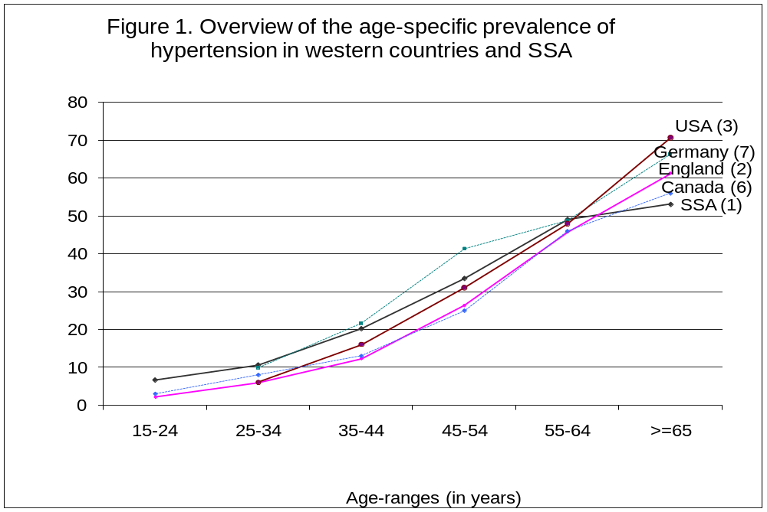
Hypertension prevalence in Africa Vs Western countries

Slide 12
Strengths of this study
Only studies from 1998 and later were included. Hence, our estimate is more representative for the current situation.
Specific data not only for age, and sex but in addition for rural and urban habitat groups.
Stringent meta-analytical techniques, such as extensive literature search, thorough quality evaluation of the studies before inclusion, and statistical pooling.
Our final analysis on 15 studies from 11 countries included only studies with the recent definition of hypertension (140/90 mmHg) and standardized hypertension measurement methods (World Health Organization STEPS-wise methodology or WHO STEPS-wise like).
We were able to expand the age –specific prevalence estimates to the age group of 15 to 24 years.

Slide 13
Limitations of the study
Lacking data : 11 countries out of 47 for SSA
  But
    ===> The population from the 11 SSA countries represented in our study sample represents 58.3% (269 million out of 461 million) of the whole SSA adult population in 2008.
    ===> Geographically : at least one country for SSA region
    ===> Theoretically, in order to estimate the mean prevalence of SSA, a random sample needed is 18.850 adult people. Our sample of 48.336 people from different SSA countries, although not being random sample of the SSA population, is more than double the required sample size.
Incomplete data
Heterogeneity

Slide 14
Conclusions
Urbanization increases the risk of hypertension in SSA (in our study by 1.51 times vs 1.24 Akikungbe et al, 1988) ;
This finding should be taken into account when estimating the burden of hypertension in SSA, where a high number of inhabitants live in rural area.
Big difference in reported prevalence between countries.
Need of National surveys in SSA.
Lower in SSA than in western countries, the prevalence of hypertension adjusted to the WHO standard population was higher in SSA. The only crude country prevalence data can be misleading as indicator for the risk for hypertension.
The higher risk was found at all age ranges, but particularly at the young age (<35 years) in SSA compared to western countries.

